Slide 1

IMDB review classification
By:
Pranay Bindela
Sneha Sharma Satheesha
Nilay Anand

Slide 2
Goals and Objectives
To classify a IMDB review into positive or negative review
To achieve highest level of accuracy in classification.
To determine which model fits better- LSTM or Transformer attention

Slide 3
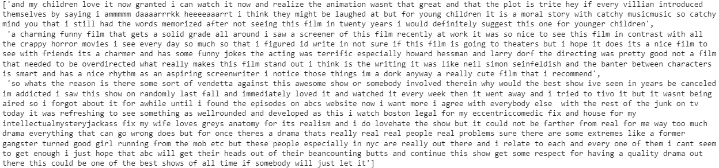
Data Source and Preprocessing
Preprocessing steps:
Lower case, lemmatization, pos tagging, unk tag, removal of stop words

Slide 4
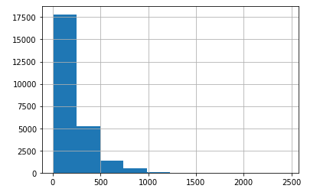
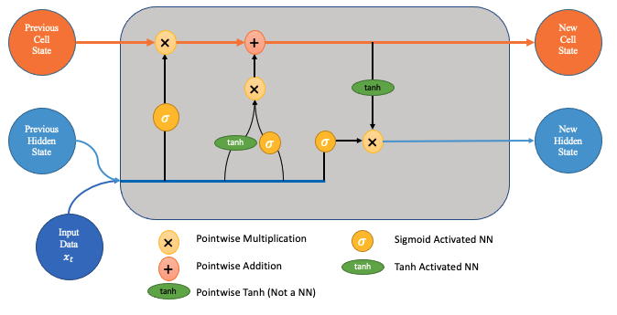
LSTM
Takes care of the Vanishing gradient problem in RNN
Cell state and hidden state are present
Gates- forget gate, input gate and update gate
Sequence Length: 278

Slide 5
LSTM Training
80% accuracy with singular LSTM with linear layer, 8 epochs, sigmoid
84% accuracy on changing activation to SoftMax
85% accuracy within 2 epochs with batch normalization after every linear layer
89% accuracy in 5 epochs using dropout layer introduced
This resulting model was trained as a language model for 7 epochs
Trained this again on IMDb classification with resultant accuracy 93% and Validation loss 0.23.
Loss function used – Negative log likelihood
Optimization - Adam optimizer, RMS Prop – 0.5,0.5
L2 Regularization does not function for any of the models

Slide 6
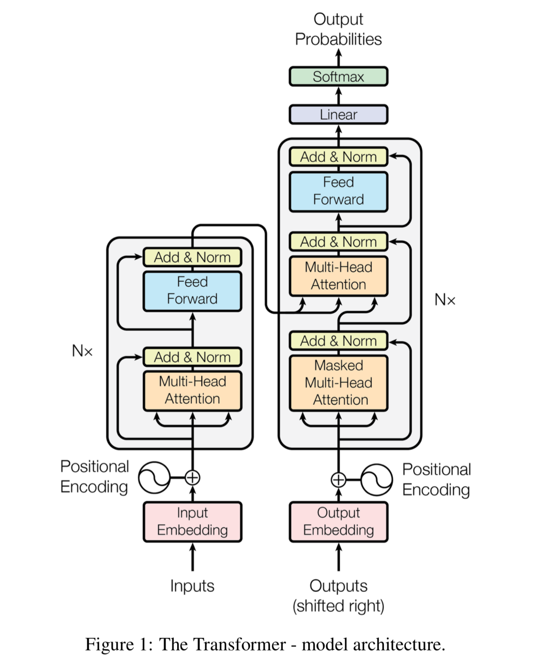
Transformer Model
Contents of Transformer Model
Encoder Layer 1. Attention layer
2. Feed Forward
Decoder Layer
Attention layers
Feed Forward
SoftMax

Slide 7
Transformer Training
This inherited all of the properties from the LSTM model
Reduce layers
Reduced dropout
Reduced embedding dropout
Reduced learning rate by 10
Used differential learning rate
Same loss functions and optimizer were used

Slide 8
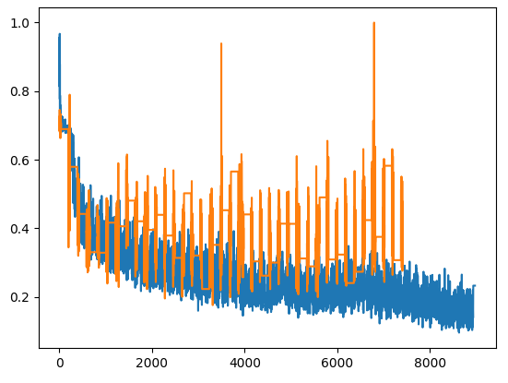
Transformers- train vs Valid Loss

Slide 9
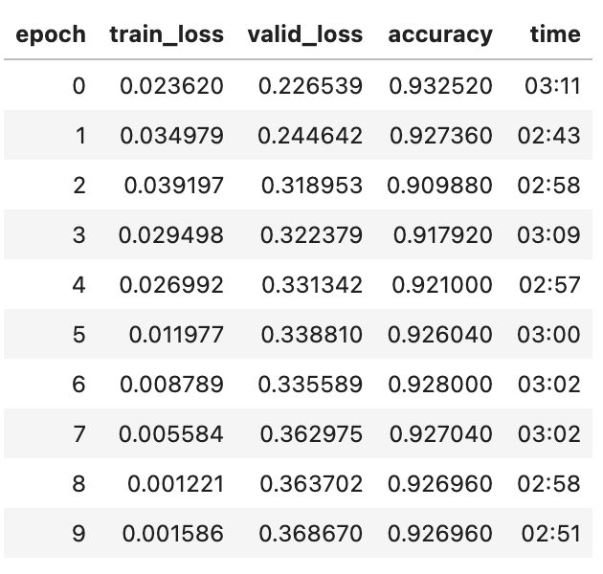
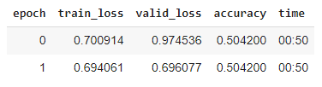
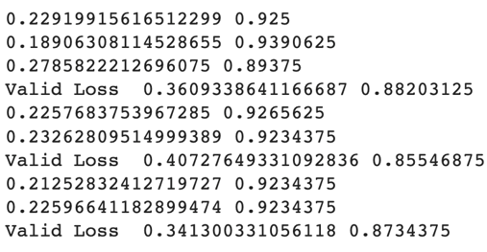
Results
LSTM Accuracy- 93%
Transformer-88%

Slide 10
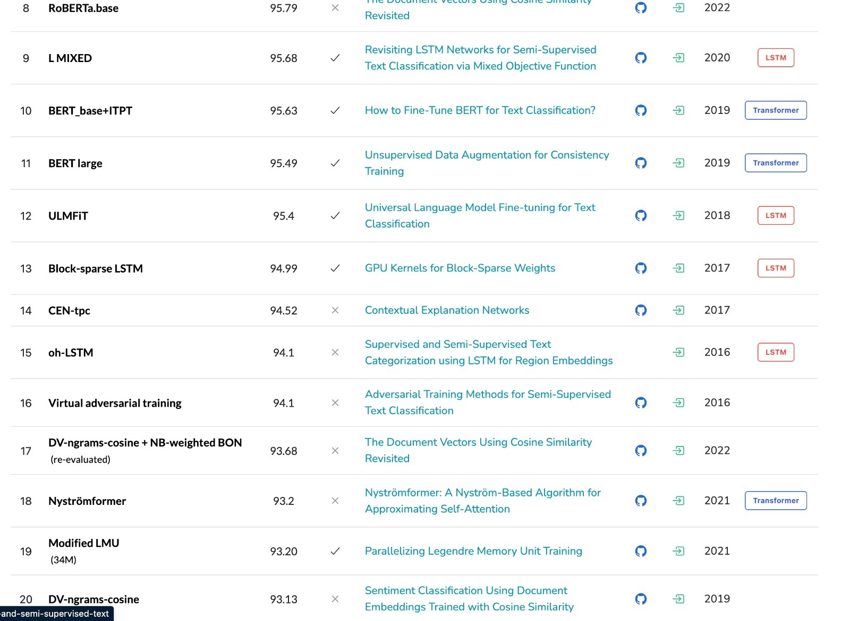

Slide 11
Cons of the models
LSTM model
They require a lot of resources and time to get trained and become ready for real-world applications
They fail to remove the vanishing gradient problem completely
Transformer Model
Attention can only deal with fixed-length text strings. The text must be split into a certain number of segments or chunks before being fed into the system as input
This chunking of text causes context fragmentation

Slide 12
Future Scope
Based on the review provided by the user, output the emotion felt when they watched the movie
Transfer learn the same primary model to determine the emotional state that may be assumed from the text through their chat sessions to avoid miscommunications.
Predict the emotional state of a chat.

Slide 13
Conclusion
We identified that transfer learnt LSTM is giving us higher accuracy in comparison with Transformers. We got an accuracy of 89% on LSTM, 93% on transfer learnt LSTM and 88% on Transformers. We have a better chance of higher accuracy on Transformers if the amount of data is increased. LSTM is a better model for classification and Transformers are better for long term contextual models like translation and language modelling.

Slide 14
Thank you
Questions?

Slide 15
References
Understanding LSTM Networks (August 27,2015) retrieved from https://colah.github.io/
Ashish Vaswani, Noam Shazeer, Niki Parmar, Jakob Uszkoreit, Llion Jones, Aidan N. Gomez, Lukasz Kaiser, Illia Polosukhin (June 12th, 2017) “Attention is all you need” retrieved from https://papers.nips.cc/

